Slide 1
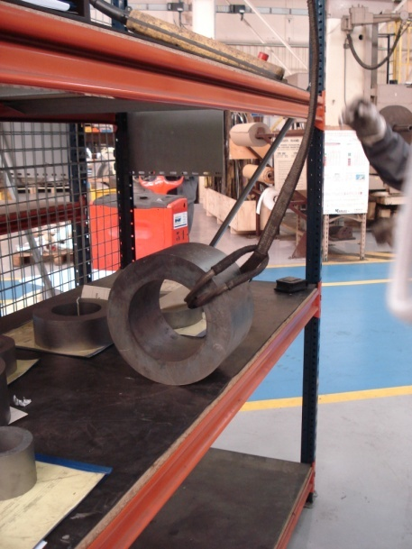
HS&E INCIDENT BULLETIN |  | 2nd Quarter 2012
Type of Incident: | Fracture
Summary:
The IP wanted to take a ring stored on a shelf (approx. 15-20kg). He noted the part was too heavy to take it manually. He put the ring on the edge to pass the sling. The crane hook was not sufficiently lowered. He turned his head to catch the control box and didn’t see the move of the ring, which rolled and fell on his foot.
Root Causes: | Actions Taken Thus Far: Next Steps
Equipment -Damaged equipment/tool/material | Remove wrench and vice from service and replace with new. Get vendor in to find new style of fitting that does not require dangerous amounts of torque. Inspect the other pipe wrenches and vices in the dept for other worn tooling.

